Slide 1
Customer Churn Prediction Preetam Narendra Soni

Slide 2
Data is about bank and the prediction was whether the employee would remain in the company or not medium size company around 10000 employees

Slide 3
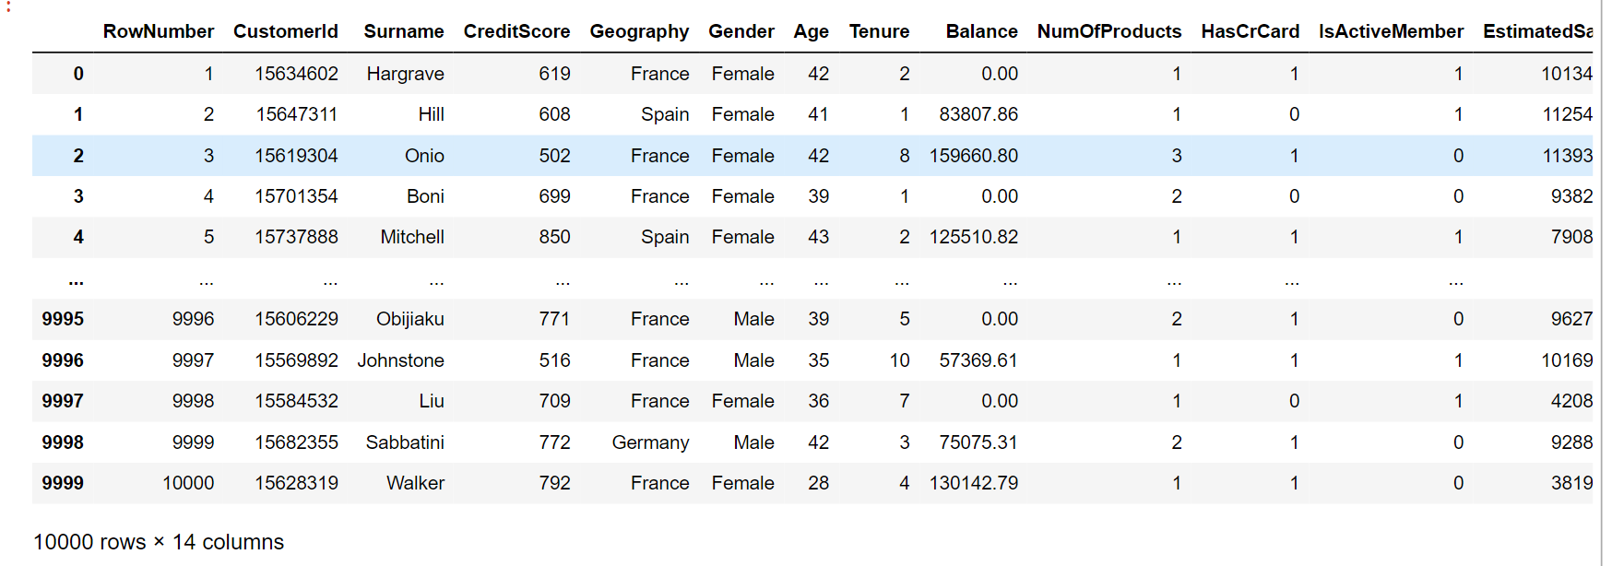

Slide 4
Project analysis slide 2
Project Analysis
Data From Kaggle
Data Size: 10000 x 14
PROJECT
Machine learning algorithm
Logistic Regression, DT, Ensemble, CNN
Accuracy and score
Comparing them and testing

Slide 5
Project analysis slide 3
Project Analysis
Data
EDA-exploratory data analysis
Data cleaning
Get model , train model and test model
Validate model
Downloaded the data from Kaggle
Analyzed the data and
Data cleaning, data completing, feature engineering
Applied different machine learing algorithm and tested
compared the accuracy

Slide 6
Project analysis slide 6
Project Analysis
Implemented machine learning algorithm
Logistic Regression
GridsearchCV with KNeighbors
Decision Tree
Random Forest
Neural Network
Mlens superlearner- Rf+XGB+GBC

Slide 7
Project analysis slide 4
Project Analysis

Slide 8
Time for training

Slide 9
Thank You

